Slide 1

WIH3007 Industrial Solution Development
ITT-TECH Inventory Price Anomaly Detection
Name: Khoo Zi Wei
Matric No: U2102814
Faculty Supervisor: Associate Prof. Dr. Azah Anir binti Norman
Company Supervisor: Surendran S Selvaraju

Slide 2
Agenda
Introduction & Objectives
Architecture Diagram
ETL Pipeline
Data Preprocessing
Feature Scaling & Model Development
Model Evaluation
Potential Feature Analysis
Data Science Solution

Slide 3



Introduction & Objectives
Introduction
High inflation drives up material costs, making inventory management critical
Protecting margins requires fixing cost variances efficiently
Machine learning detects hidden pricing anomalies for smarter decisions
Objectives
Detecting anomalies in inventory landing cost
Investigating & Validating anomalies
Understanding root cause & Quantifying impact
Notes:
To recap, this project addresses the challenges faced by stakeholders in managing inventory, particularly in identifying pricing anomalies and visualizing cost variances. To tackle this, the aim was to implement a machine learning solution for detecting anomalies in pricing trends and present the insights through the Power BI dashboard.

Slide 4
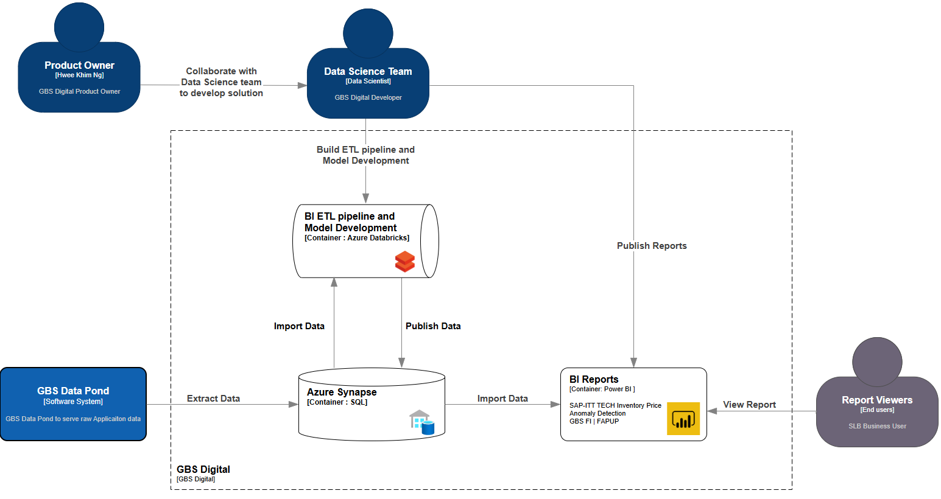
Architecture Diagram

Slide 5




ETL Pipeline
Data Source
Azure Databricks
Azure Synapse
Extract
Load
ERE-BB-3645
Transform
GBS Digital SQL Database
PO Detail
Material Prices Detail
Standard Cost Component Detail
Column-level transformations
Merge data using left outer join
Apply conditional logic
PO table
EMS table

Slide 6
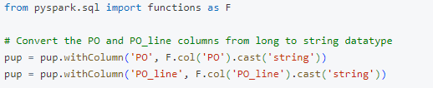
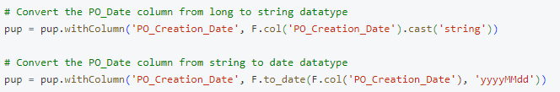
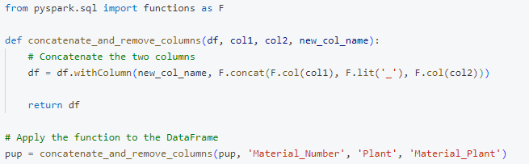
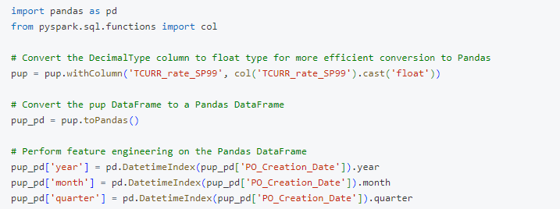
Data Preprocessing
Input Data: POUP
Data Type Conversion
PO, PO_line: Integer -> String
PO_Creation_Date: Integer -> Date
Concatenation
Material_Number + Plant -> Material_Plant
Time Features Extraction
PO_Creation_Date -> year, month, quarter

Slide 7
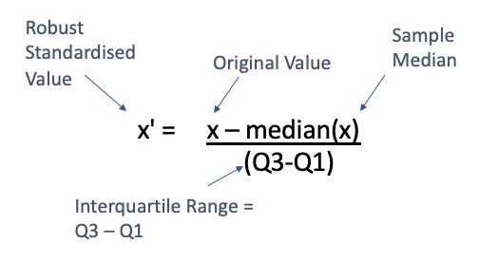


Feature Scaling & Model Development
Feature Scaling – Robust Scaling
Handle varying unit price scales across Material_Plant
Mitigate impact of outliers
Model Development – DBSCAN Model
Anomaly detection on scaled POUP (Purchase Order Unit Price)
Automatically identifies clusters and outliers without predefined labels
Training Dataset Features
Year
Month
Scaled Unit Price
Model Criteria
Random Seed: 42
Epsilon (ε): 0.1
Minimum Samples: 20, 25

Slide 8



Model Evaluation
Product Owner's Feedback
Evaluated anomalies based on 4 key metrics
(TP, TN, FP, FN)
Metrics aligned with financial expertise and business requirements
DBSCAN Model
Fine-tuned parameters for optimal performance
Increasing Min Samples and decreasing Epsilon could improve accuracy
Final Model Chosen
Avoids overfitting and meets business needs
Recall: 85% (validated by Product Owner on 20% of the dataset)
Notes:
To evaluate the anomaly detection results, we incorporated feedback from the product owner, who reviewed anomalies based on her financial expertise and business requirements. The evaluation was based on four key metrics, which are True Positive, True Negative, False Positive and False Negative. Initially, we implemented the Isolation Forest model but it showed a low accuracy. After discussion with my manager and mentor, we decided to switch to the DBSCAN model, which performed better in detecting pricing anomalies. During parameter fine-tuning, we observed that increasing the minimum samples and decreasing epsilon will improve the model's accuracy. After several iterations, we set the parameter values that struck a balance between accuracy, and avoiding overfitting while meeting the business requirements. The final model achieved 84% precision, which is validated by the product owner using 20% of the dataset.

Slide 9




Potential Feature Analysis
Univariate Check for Anomalies across Material_Plant
Vendor Check
Starting from the 4th record, if any vendor is different from the previous 3 records
Currency Check
If the exchange rate is outside the normal range (Mean ± 2 STD)
Starting from the 4th record, if currency changes from the previous 3 records
Quantity Check
If Quantity > Q3 and Price < Avg Price in Q3
If Quantity < Q1 and Price > Avg Price in Q1
First 3 records: "Undefined“
If any condition above is met: Label as "Vendor Name", "Currency" or "Quantity“
If none are met: Label as "Seasonal Trend"

Slide 10
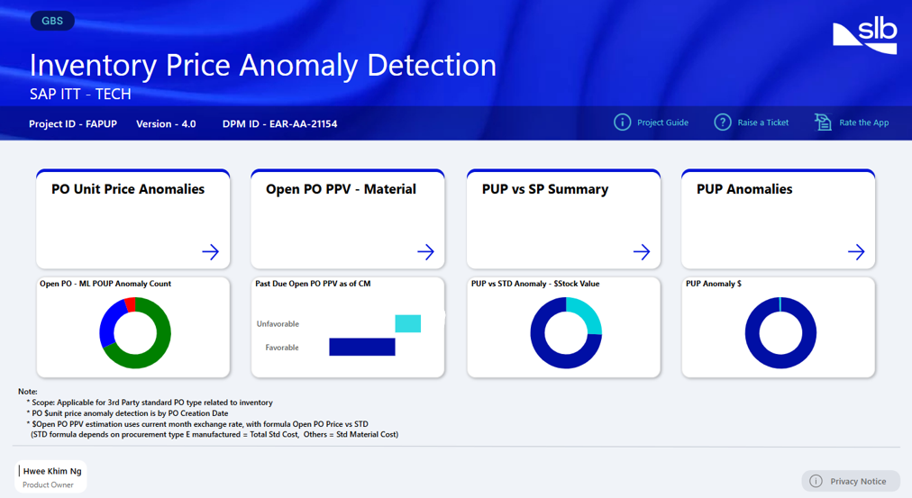
Data Science Solution
Landing Page
Link: https://app.powerbi.com/groups/me/reports/ffc7441e-cf6f-4884-a23e-03451441b4ca/ReportSection1748058027beaeb4025c?experience=power-bi
Notes:
This is the landing page of the Power BI dashboard for the project. It consists of four main sections which are the PO Unit Price Anomalies page, the Forward PPV page, the Standard Cost Component page and lastly the Details page.

Slide 11
Thank you

